Slide 1
Particle Swarm Optimization (PSO)
Group Members:
Syeda Areesha Najam
Shalin Amir Ali
Sana Fatima

Slide 2
What is PSO?
A population based stochastic algorithm based on metaheuristic approach.
Used in numerical optimization problems.
An inspiration from social foraging behaviors of animals.
Also classified as swarm intelligence algorithm like,
bacterial foraging algorithm
ant colony algorithm etc.
Example: predicting score of a football team using a math equation.

Slide 3
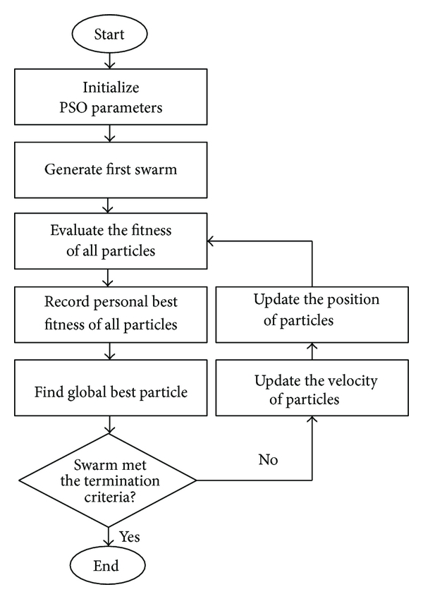
PSO Flowchart: An approach towards PSO problem

Slide 4
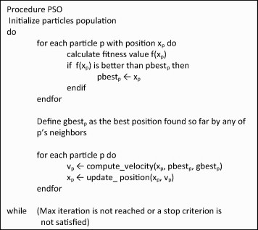
PSO Algorithm:
https://www.researchgate.net/figure/The-pseudocode-of-the-PSO-algorithm_fig8_274460300

Slide 5
Important concepts and functions in PSO.

Slide 6
Theoretical Analysis (time complexity)

Slide 7
Implementation of PSO

Slide 8
Experimental Analysis

Slide 9
References:
https://www.researchgate.net/figure/The-pseudocode-of-the-PSO-algorithm_fig8_274460300
https://www.hindawi.com/journals/tswj/2014/973093/fig1/

